Slide 1

CSE 350
Digital Electronics and Pulse Techniques
Diode Logic
Course Instructor: Shomen Kundu (SDU)
Mail: shomen.kundu@bracu.ac.bd
Desk: #4N148

Slide 2
Review ( Electronic Circuits and Devices)
Semiconductor ( Si )
Intrinsic Semiconductor: pure semiconductor crystal
Extrinsic Semiconductor: impurity is being added.
Extrinsic Semiconductor is of two types:
n-type: Majority electron, Minority hole
p-type: Majority hole , Minority electron

Slide 3
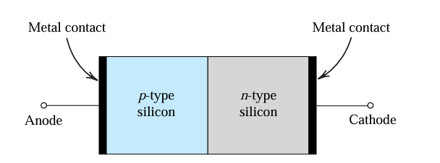
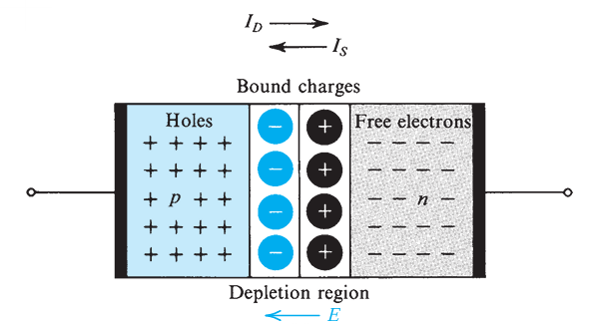
Review ( Electronic Circuits and Devices)
Diode:
Fig: Simplified physical structure of the pn junction.
Fig: pn junction with no applied voltage

Slide 4
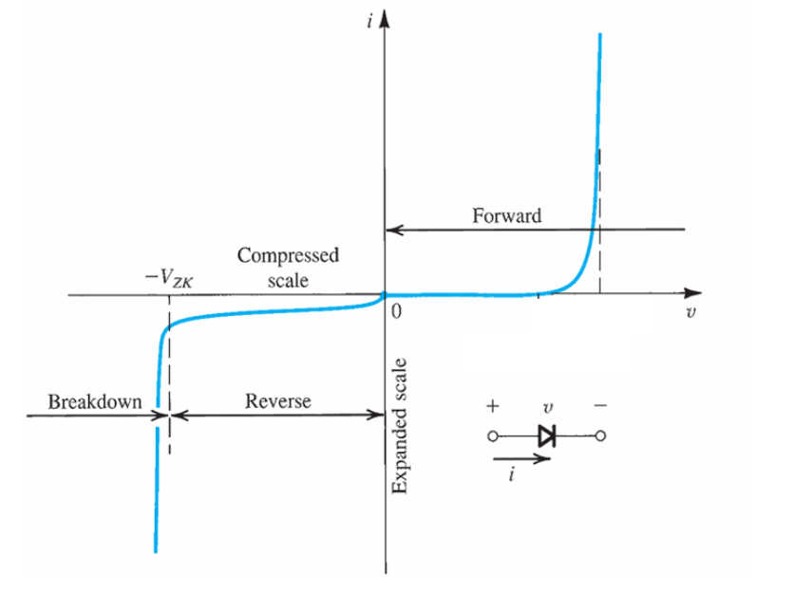
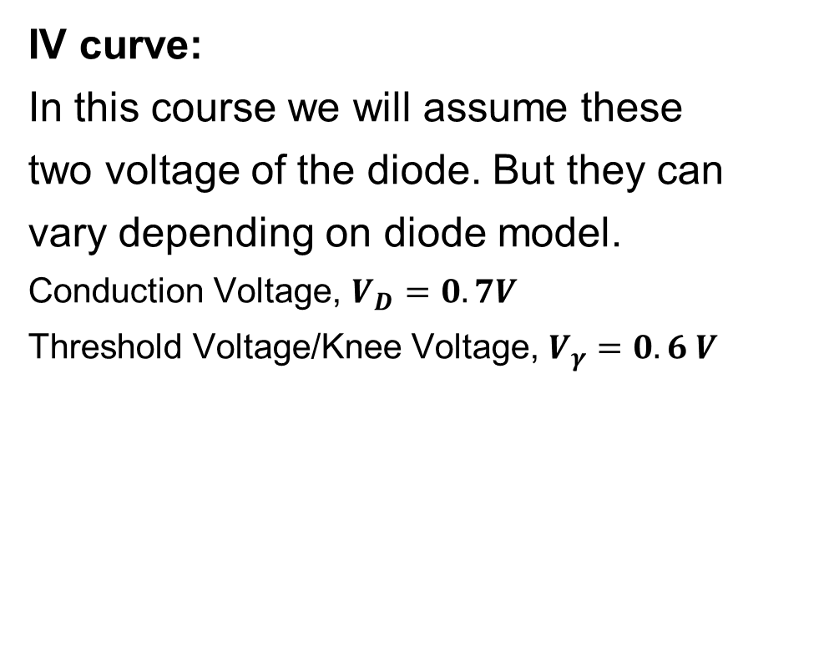
Review ( Electronic Circuits and Devices)
IV curve:
In this course we will assume these
two voltage of the diode. But they can
vary depending on diode model.
Conduction Voltage, $V_{D}=0.7V$
Threshold Voltage/Knee Voltage, $V_{γ}=0.6 V$
Fig: The I-V characteristic of the pn junction showing the rapid increase in reverse current in the breakdown region.

Slide 5
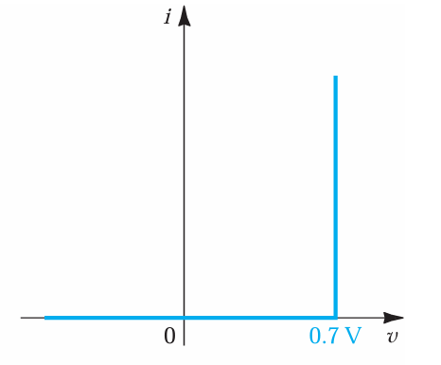
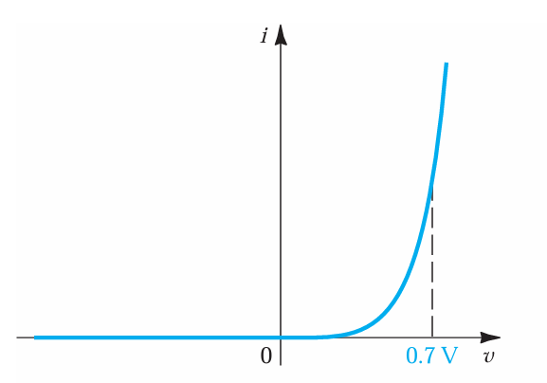

Review ( Electronic Circuits and Devices)
The Constant-Voltage-Drop Model:
The simplest and most widely used diode model is the constant-voltage-drop model. This model is based on the observation that a forward-conducting diode has a voltage drop that varies in a relatively narrow range, say 0.6 to 0.8 V. The model assumes this voltage to be constant at a value, say, $V_{D}=0.7 V$.

Slide 6
Review ( Electronic Circuits and Devices)
Conductance voltage (V_{D}) of different diode for constant voltage drop model:
Ideal diode: V_{D} = 0 V
Ge diode: V_{D} = 0.3 V
Si diode: V_{D} = 0.7 V (will be used most of the time )
We will use Si diode with constant voltage model for simplicity. If nothing is mentioned in the question, we will assume Si diode.

Slide 7
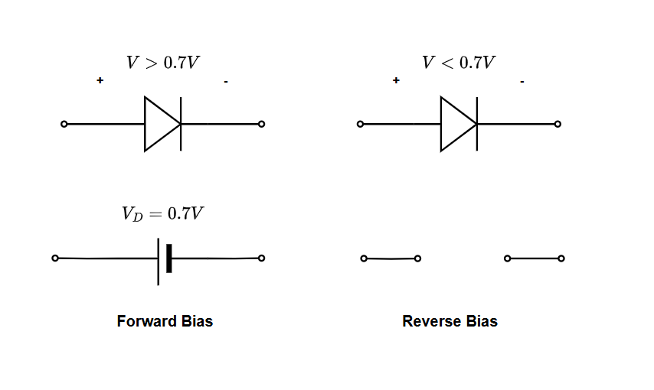

Review ( Electronic Circuits and Devices)
Equivalent circuit of Si diode for constant voltage drop model:
$$V<0.6 V$$

Slide 8
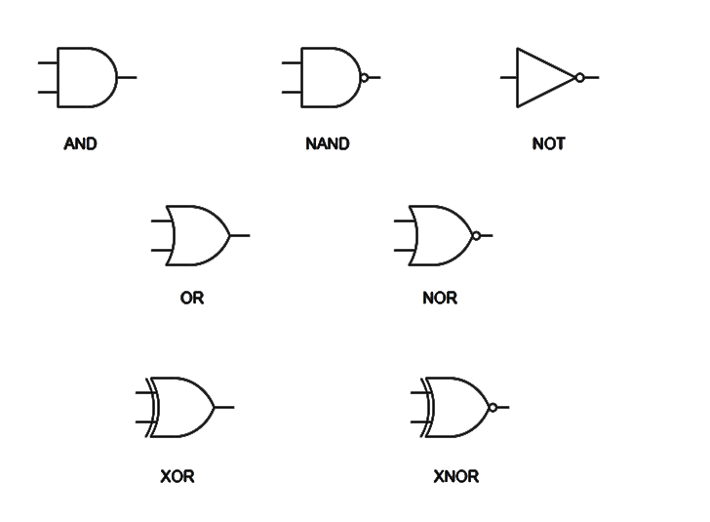
Abstract of Logic Gate:
This gates are abstract, because they just represent logical operations.

Slide 9
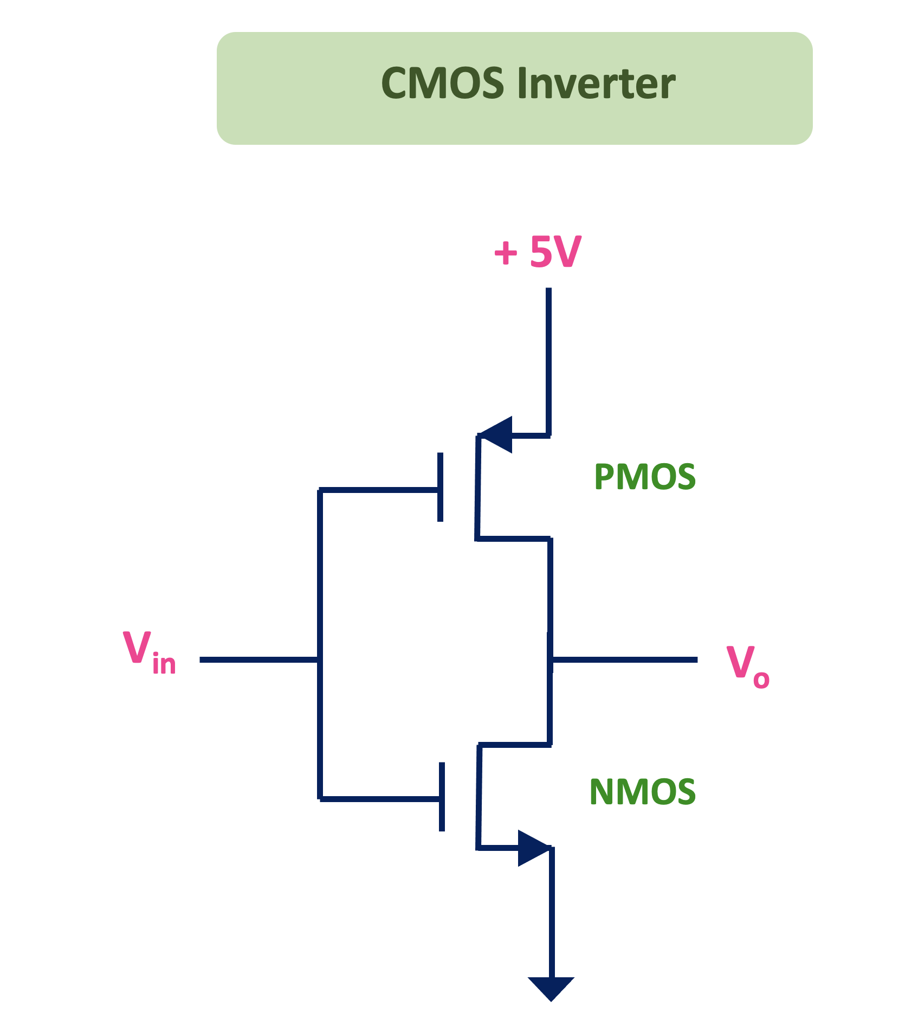
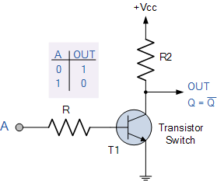
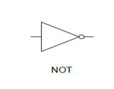
Logic families

Slide 10
Logic families
Digital Logic Families
Bipolar logic families
(electron and hole both are used as charge carrier)
Example: BJTs
Unipolar logic families
(Only one type of charge carrier dominates)
Example: MOSFET, JFET
i. PMOS logic families
ii. NMOS logic families
iii. CMOS logic families
Saturated
(saturation and Cutoff)
Unsaturated
(Active & Cutoff)

Slide 11
Logic families
Saturated Logic Family: Uses Saturation & Cutoff region of a BJT for implementation of logic states.
  Resistor Transistor Logic (RTL)
  Diode Transistor Logic (DTL)
  Transistor-Transistor Logic (TTL)
Unsaturated Logic Family: Uses Active & Cutoff region of a BJT for implementation of logic states.
  Schottky TTL

Slide 12
Logic families
Unipolar Logic Family: JFET, MOSFET etc. single charge carrier-based transistor logic families.
PMOS Logic Family
NMOS Logic Family
CMOS Logic Family

Slide 13
Diode logic
OR gate and AND gate
Design Techniques,
For each input we need a series resistance and a diode
Output will be connected with GND or VDD
For OR gate output will be connected to the GND via pull down resistance
For AND gate output will be connected to the VDD via pull up resistance.
Series resistance will be small.
Pull up / Pull down resistance will be large.

Slide 14
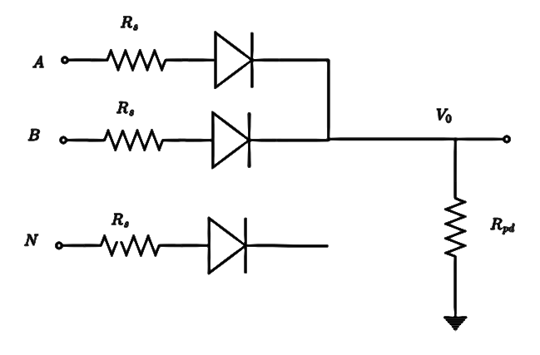

Diode logic
OR Gate
Series and pull down
resistance can be chosen as
$R_{s}=1 kΩ$(low)
$R_{pd}=100 kΩ$ (high)

Slide 15
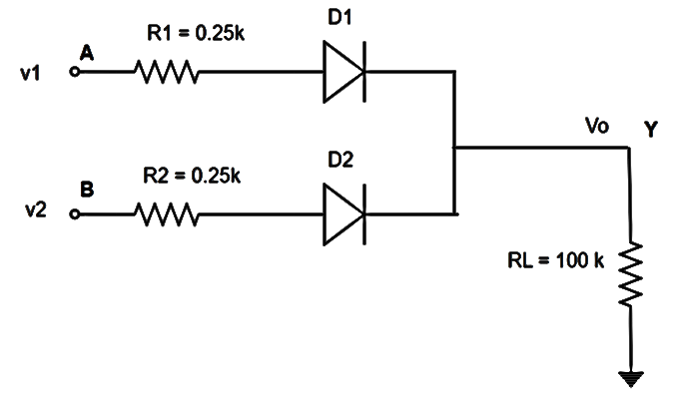
Diode logic
Two input OR Gate
A | B | V1 | V2 | Vo | Y
0 | 0 | 0V | 0V
0 | 1 | 0V | 5V
1 | 0 | 5V | 0V
1 | 1 | 5V | 5V
Assume: Logic 1 means 5 V on input side. Logic 0 means 0 voltage/GND

Slide 16
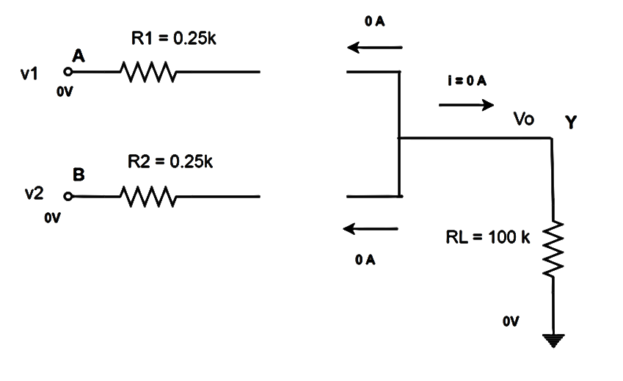


Diode logic
Case 1: A = 0, B = 0
First thing to check whether diodes are on or off.
FACT: We need at least 0.7 V to turn on any diode.
Conclusion: D1 and D2 are OFF.
$$\frac{Vo −0}{100k}=i=0 =>Vo=0 V$$
$$Y=0 ( logic)$$

Slide 17
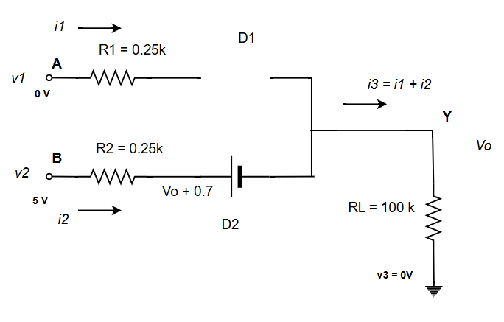
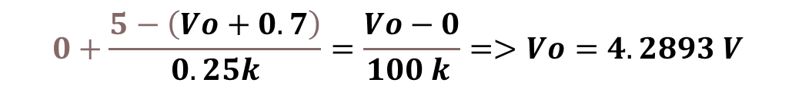


Diode logic
Case 2: A = 0, B = 1
First thing to check whether diodes are on or off.
# Here: $D_{1}$ will be OFF and $D_{2}$ will be ON
$$0+\frac{5−\left(Vo+0.7\right)}{0.25k}=\frac{Vo−0}{100 k }=>Vo=4.2893 V$$
$$Y=1 ( logic)$$

Slide 18
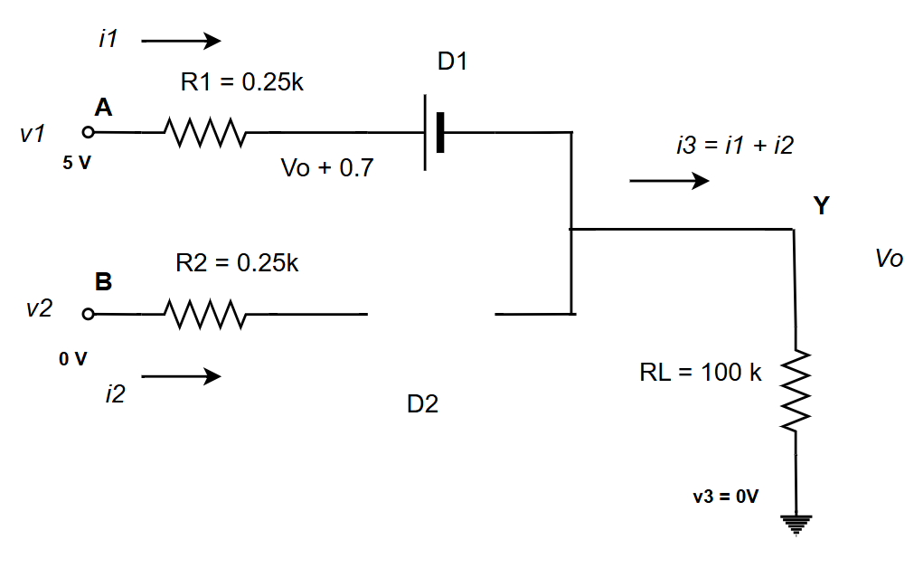
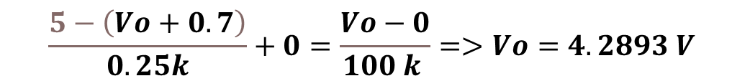

Diode logic
Case 3: A = 1, B = 0 ( symmetrical to case 1 )
First thing to check whether diodes are on or off.
# Here: D1 will be ON and D2 will be OFF
$$\frac{5−\left(Vo+0.7\right)}{0.25k}+0=\frac{Vo−0}{100 k }=>Vo=4.2893 V$$
$$Y=1 ( logic)$$

Slide 19
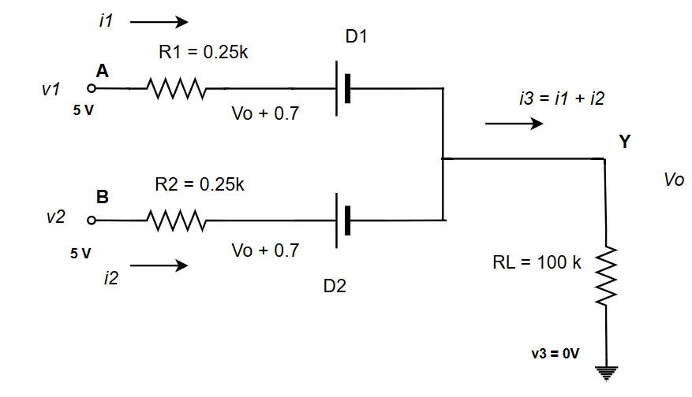
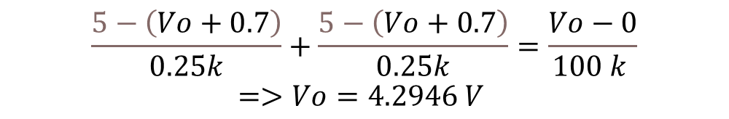

Diode logic
Case 4: A = 1, B = 1
First thing to check whether diodes are on or off.
# Here: D1 will be ON and D2 will be ON
$$\frac{5−\left(Vo+0.7\right)}{0.25k}+\frac{5−\left(Vo+0.7\right)}{0.25k}=\frac{Vo−0}{100 k }$$
$$=>Vo=4.2946 V$$
$$Y=1 ( logic)$$

Slide 20

Diode logic
A | B | V1 | V2 | Vo | Y
0 | 0 | 0V | 0V | 0 V | 0
0 | 1 | 0V | 5V | 4.2893V | 1
1 | 0 | 5V | 0V | 4.2893V | 1
1 | 1 | 5V | 5V | 4.2946 V | 1
Two input OR Gate Findings
#4.28 V , 4.29 V
# logical High and Low can be
Different at input and output side
$V_{OH}$ = 4.28 V
( lowest of the outputs values
that can be considered as logic 1 )

Slide 21
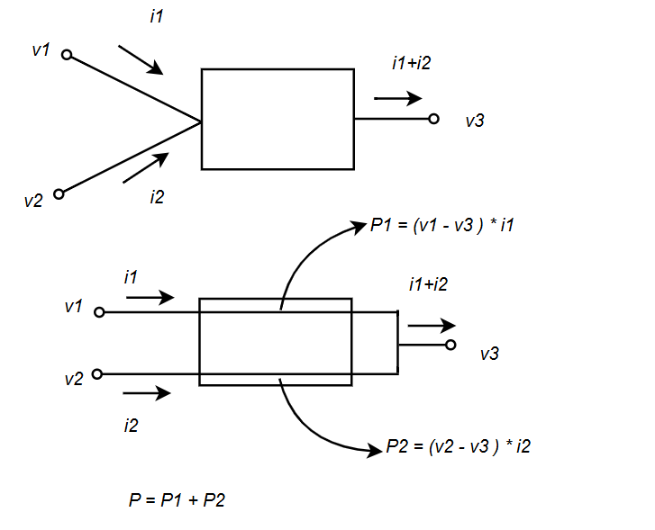
Power Dissipation Calculation
Theory:

Slide 22
Max Power Dissipation
Example: Find the max power dissipation of the given circuit.

Slide 23
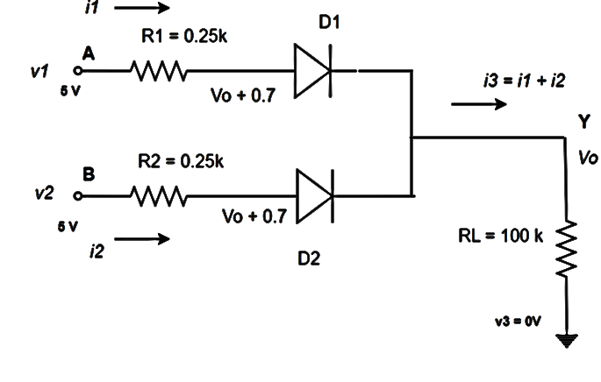

Max Power Dissipation
Max power dissipation will be in the case 4
$$V_{0}=4.2946 V$$
$$i1= \frac{5−( V_{0}+0.7)}{0.25 k}=0.0216 mA$$
$$i2=i1$$
$$i_{3}=\frac{V_{0}−0}{100k}=0.042946 mA$$
$$P=\left(5−0\right)∗i_{1}+\left(5−0\right)∗i_{2}= 0.216 mW$$
Or $P=\left(5−0\right)∗i_{3}=0.216 mW$

Slide 24
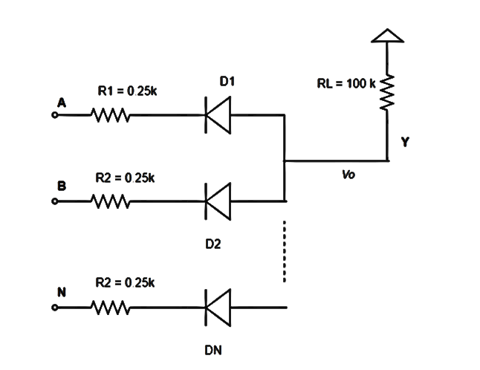
Diode logic
AND gate:

Slide 25
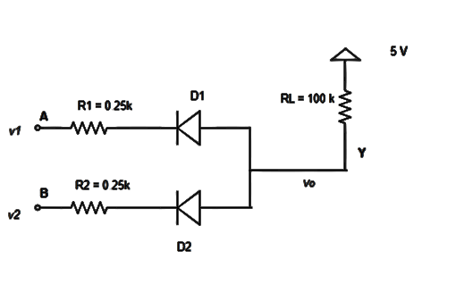
Diode logic
Exercise: Analysis the four possible input and fill the table. Also find the V_{OL} for this circuit.
A | B | V1 | V2 | Vo | Y
0 | 0 | 0V | 0V
0 | 1 | 0V | 5V
1 | 0 | 5V | 0V
1 | 1 | 5V | 5V
Hints: Logical low voltage at the output side --→ Highest voltage for which the output is considered to be 0 or logic low.

Slide 26
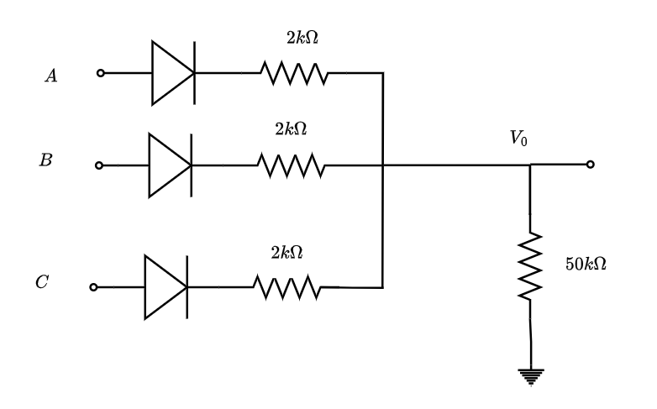

Diode logic
Try yourself,
1. Design a logic circuit, $Y=A\left(B+C\right)$ using diode logic.
2. For the given circuit find the maximum
power and average power.

Slide 27
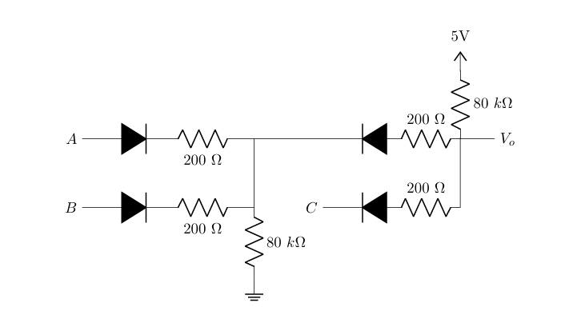

Diode logic
Try yourself,
Here, Logical High is 5V and Logical Low is 0V, $V_{D}=0.7 V and V_{γ}=0.6 V$
1. Determine the logic function this circuit is implementing.
2. Calculate the output voltage and power dissipation of the entire circuit when A=Low, B=High, C=Low.

